Slide 1
Miocardioscintigrafia
9.07.2020

Slide 2
Indicazioni
Valutazione della cardiomiopatia ischemica (presenza, sede, severità, estensione della necrosi, valutazione funzionale della stenosi)
Valutazione della vitalità miocardica
Stratificazione prognostica dopo infarto del miocardio o prima di interventi chirurgici
Valutazione del trattamento emodinamico
Valore prognostico

Slide 3
Preparazione del paziente
Gravidanza (controindicazione assoluta)
Se allattamento sospendere almeno 24-48h dall’esame
Digiuno di almeno 4 ore prima dello stress
Sospendere i farmaci (valutare con lo specialista)
  Nitroderivati (almeno 3 ore prima)
  Beta-bloccanti, calcio antagonisti e nitroderivati a lunga azione (almeno 48 ore prima)

Slide 4
Stress test
Esercizio fisico (raggungimento della FCMT fino ad 85%) e continuazione dopo almeno 1-2 min dalla somm del tracciante (aumento del consumo di ossigeno e quindi della perfusione miocardica)
Adenosina (infusione continua 0.14 mg/kg iniezione del RF dopo 2-3 min e prosecuzione per altri 3 min) (vasodilatatori con induzione della iperemia coronarica o riserva coronarica)
Dipiridamolo (infusione 0.56 mg/kg in 4 min) (induce iperemia coronarica)
Regadenoson (iniezione in bolo di 400 microg/5ml seguiti da lavaggio, iniezione del RF immediatamente dopo) (induce iperemia coronarica)
Dobutamina (dosi crescenti con iniezione di 3 min e continuazione per ulteriore 3 min della infusione (incrementa la domanda miocardica di ossigeno)

Slide 5
Come scegliere lo stress test
Confrontarsi con il clinico
Controindicazioni assolute e relative, es:
  BPCO
  Aterosclerosi severa
  Recente evento ischemico
  …..altro

Slide 6
Radiofarmaci
Tallio-201 (obsoleto)
99mTc-sestamibi
99mTc-tetrofosmina

Slide 7
CARATTERISTICHE DEI TRACCIANTI DI PERFUSIONE MIOCARDICA
TALLIO
SESTAMIBI
TETROFOSMINA
Classificazione
Elemento
Isonitrile
Difosfina
Carica
Catione
Catione
Catione
Trasporto
Attivo
Passivo
Passivo
Preparazione
Ciclotrone
Kit
Kit
Frazione di estrazione
0.85
0.40
0.24
Tempo di imaging
1 min
30-60 min
5-15 min
Redistribuzione
Si
No
No
SPECT
Si
Si
Si
Gated SPECT
Possibile
Si
Si
Clearance
Renale
Epatica
Epatica

Slide 8
Flusso coronarico e scelta del tracciante
L’abilità di evidenziare una stenosi coronarica è legata allo sviluppo di un differente flusso ematico tra i vasi normali e i vasi patologici
L’ evidenza di queste disparità dipende dall’abilità del radiotracciante di riflettere l’incremento di flusso ematico prodotto dallo stress
Elevata frazione di estrazione miocardica
Estrazione mantenuta attraverso il range di aumentato flusso

Slide 9
Cinetica miocardica dopo esercizio

Slide 10
Protocolli di acquisizione
Protocollo in doppia giornata
Stress - riposo
Riposo - stress
Protocollo in singola giornata
Stress - riposo
Riposo - stress
Riposo - stress
(doppio tracciante)

Slide 11
Protocollo in singola giornata stress -riposo
Traccianti marcati con Tc-99m
Sestamibi o
Tetrofosmina
(10 mCi e.v.)
Sestamibi o
Tetrofosmina
(30 mCi e.v.)
Esercizio
SPECT
Riposo
SPECT
0 Picco 30/45 min 3 ore 30 min/1 ora esercizio
Tempo

Slide 12
Protocollo in singola giornata riposo-stress
Traccianti marcati con Tc-99m
Sestamibi o
Tetrofosmina
(10 mCi e.v.)
Sestamibi o
Tetrofosmina
(30 mCi e.v.)
Riposo
SPECT
Esercizio
SPECT
0 30min/1 ora 3 ore 30/45 min
Tempo

Slide 13
Protocollo in doppia giornata
riposo-stress/stress-riposo
Traccianti marcati con Tc-99m
VANTAGGI
Alta dose di tracciante sia per lo studio dopo stress sia per lo studio a riposo
Immagini di elevata qualità ed elevata statistica di conteggio per una adeguata valutazione della perfusione miocardica
SVANTAGGI
Due giornate di imaging
Ritardo nella interpretazione dell’esame

Slide 14
Protocollo in singola giornata
riposo-stress/stress-riposo
Traccianti marcati con Tc-99m
Protocollo riposo-stress
SVANTAGGI
Riduzione del contrasto del difetto dopo stress
15% circa della radioattività al momento dello stress proviene dalla distribuzione miocardica del tracciante a riposo
Protocollo stress-riposo
VANTAGGI
Tempo di acquisizione delle immagini analogo all’imaging con Tallio
SVANTAGGI
Rate di conteggio non ideale presente nell’ immagine dopo stress

Slide 15
Stress Farmacologico
Dipiridamolo
Traccianti marcati con
Tc-99m
Dipiridamolo 0.56 mg / kg in 4 min
Dipiridamolo 0.76 mg/kg in 6 min
SPECT
1 2 3 4 5 6 7
30/45
Tempo (min)

Slide 16
Stress Farmacologico
Adenosina
Traccianti marcati con
Tc-99m
Adenosina 140 mcg / kg / min in 6 min
SPECT
1 2 3 4 5 6 7
30/45
Tempo (min)

Slide 17
Stress Farmacologico
Dobutamina
Traccianti marcati con
Tc-99m
Dobutamina 5 µg / kg / min in 8 min
SPECT
0 2 4 6 8 10 12
30/45
Time (min)

Slide 18
Stress Fisico o Farmacologico
Può il paziente eseguire l’esercizio?
SI
NO
Non chiaro
Imaging con
esercizio
Broncospasmo?
Dipiridamolo
COPD? Caffeina?
+ Esercizio
Si
No
Dobutamina
Dipyridamolo

Slide 19
Imaging di Perfusione Miocardica
Stress Farmacologico
Pazienti impossibilitati ad eseguire un adeguato stress fisico
Donne con sospetta patologia coronarica
Pazienti con blocco di branca sinistra

Slide 20
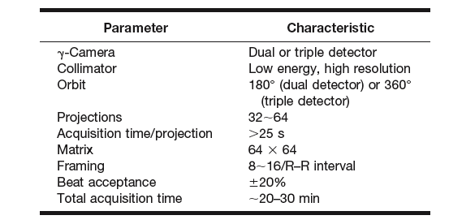
GATED SPECT
Acquisition Parameters

Slide 21
Metodi di ricostruzione
FBP con filtri (Butterworth con cut-off 0,28 cicli/cm, ordine 10)
Iterativa (OSEM e metodologia RR)

Slide 22
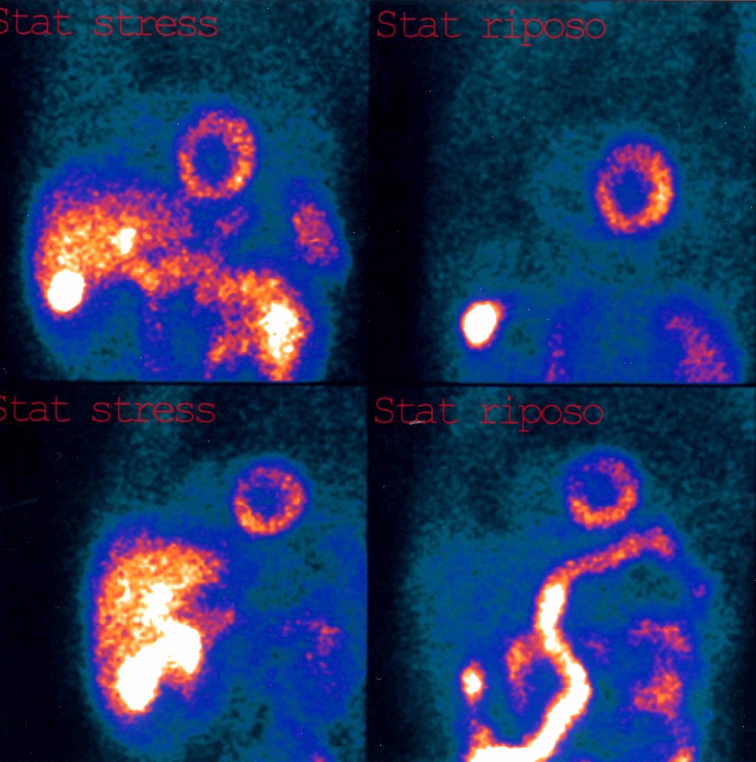
Ipercaptazione epatica,Ristagno del tracciante in colecisti
Sforzo Riposo
fegato
colecisti
fegato
colecisti

Slide 23
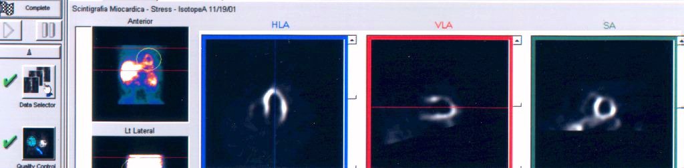
Riconoscimento Manuale
Riorientamento Semi-automatico
ROI del VS manuale
Correzione manuale

Slide 24
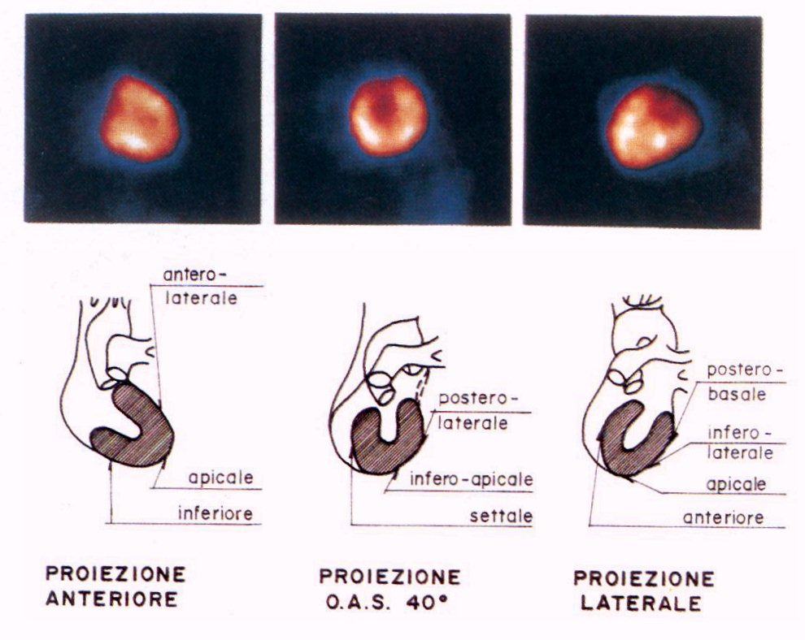
ANATOMIA DEL VENTRICOLO SINISTRO

Slide 25
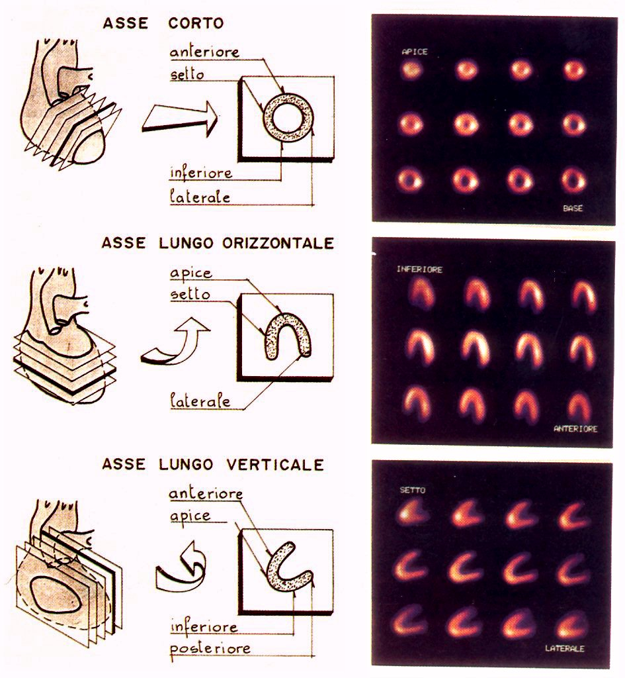
ANATOMIA SPET
DEL
VENTRICOLO
SINISTRO

Slide 26
Irrorazione Miocardica
Coronaria discendente anteriore
Coronaria circonflessa
Coronaria destra
Parete anteriore
e setto interventricolare
Parete laterale
Parete inferiore

Slide 27
SEMEIOTICA IN SPECT MIOCARDICA
Omogenea distribuzione del tracciante di perfusione nel VS sia sotto sforzo che a riposo QUADRO NORMALE
Deficit Reversibile (presente sotto sforzo, assente o chiaramente ridotto a riposo)
ISCHEMIA MIOCARDICA
Deficit Irreversibile (o fisso, cioè immodificato tra sforzo e riposo)
PREGRESSA NECROSI MIOCARDICA

Slide 28
SEMEIOTICA IN SPECT MIOCARDICA
Ipercaptazione polmonare nella SPET sotto sforzo
Dilatazione reversibile della cavità del Ventricolo Sinistro:
SEGNI INDIRETTI DI DISFUNZIONE VENTRICOLARE SINISTRA DA SFORZO

Slide 29
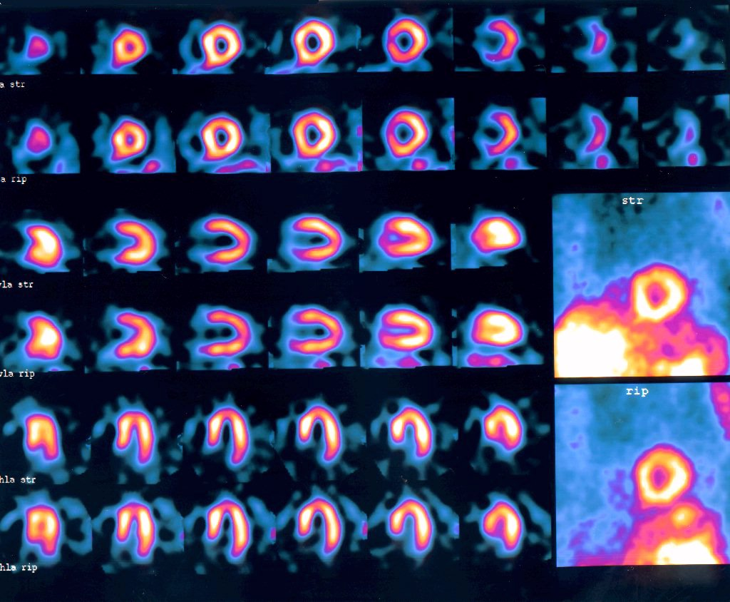
NORMALE

Slide 30
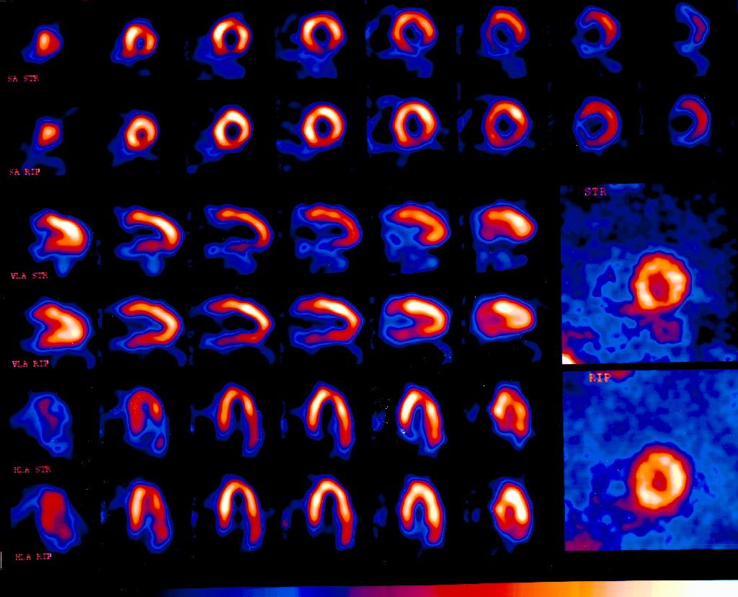
DEFICIT REVERSIBILE
università cattolica - roma

Slide 31
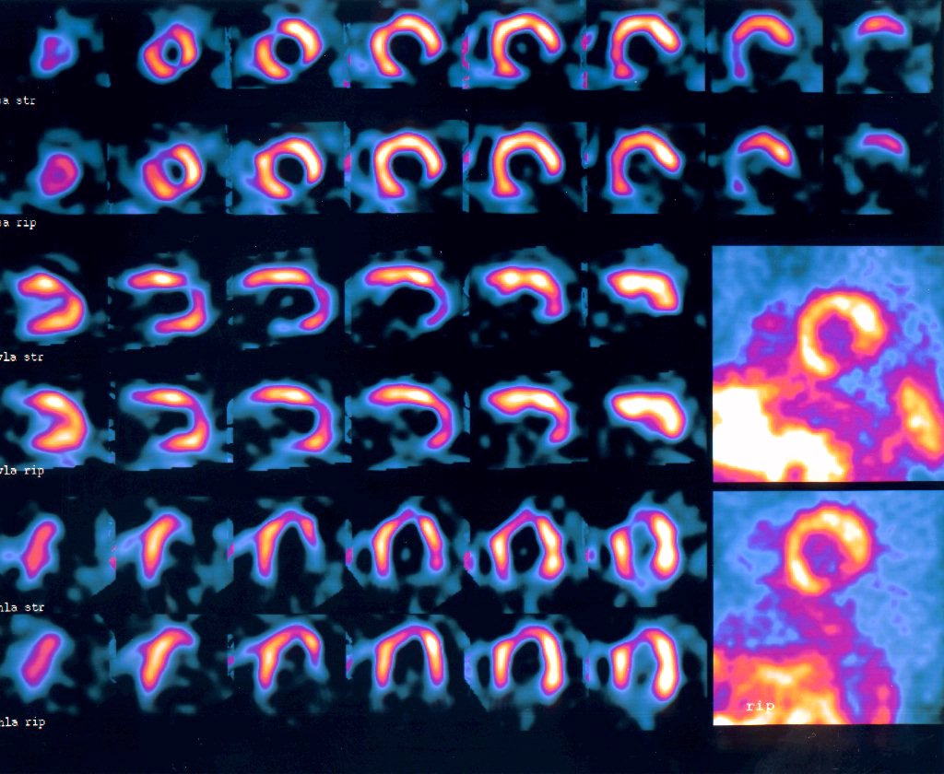
DEFICIT IRREVERSIBILE

Slide 32
Imaging di Perfusione Miocardica
Stress
SA
HLA
VLA
Riposo
SA
HLA
VLA
Normale Perfusione

Slide 33
Imaging di Perfusione Miocardica
Ischemia miocardica (parete laterale)

Slide 34
Imaging di Perfusione Miocardica
Stress
SA
HLA
VLA
Riposo
SA
HLA
VLA
Infarto miocardico (pareti inferiore e laterale)

Slide 35
GATED SPECT
Basic Principles, Technical Aspects and Clinical Application

Slide 36
GATED SPECT
General Principles
Gating and Framing
Heartbeat Variation and Tolerance
Quantitation

Slide 37
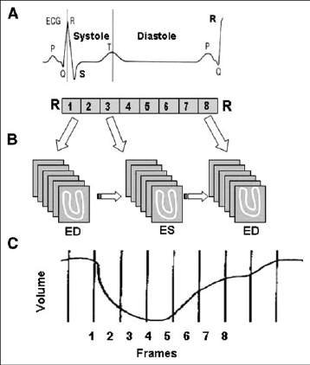
ECG-Gated
General Principles
Gating and Framing:
8 frames per cardiac cycle is satisfactory
Greater number of frames gives better temporal resolution but lower counts
8-frame LVEF is 3 units lower than 16-frame, but the relatioship is fairly uniform

Slide 38
ECG-Gated
General Principles
Heartbeat Variation and Tolerance
Flashing artifact
Temporal blurring
Acceptance window

Slide 39
GATED SPECT:
Measurement and Analysis
Quantification
  Myocardial perfusion
  LV systolic function
  LV diastolic function
  Cardiac geometry

Slide 40
GATED SPECT:
Measurement and Analysis
Quantification
  Regional myocardial perfusion and function
  LV systolic function
  LV diastolic function
  Cardiac geometry

Slide 41
Standardized myocardial segmentation for SPECT imaging of the heart
Short Axis
Vertical Long Axis
Apical
Mid
Basal
Mid
7
1
13
8
12
2
6
14
16
17
9
11
3
5
15
10
4
AHA Scientific Statement. Circulation 2002

Slide 42
Image analysis
Segmental visual scoring of tracer activity
0 = normal tracer uptake
1 = mild reduction of tracer uptake
2 = moderate reduction of tracer uptake
3 = severe reduction of tracer uptake
4 = absent tracer uptake

Slide 43
Variables incorporating the extent and severity of perfusion defects
Summed stress score (ischemia + scar)
  Sum of all segmental stress scores
Summed rest score (scar)
  Sum of all segmental rest scores
Summed difference score (ischemia)
  Sum of differences between stress and rest scores

Slide 44
Summed stress score
Normal
  SSS ≤3 (0-4% of abnormal myocardium)
Mildly abnormal
  SSS 4-7 (5-10% of abnormal myocardium)
Moderately abnormal
  SSS 8-10 (11-15% of abnormal myocardium)
Severely abnormal
  SSS >10 (≥16% of the abnormal myocardium)

Slide 45
Summed difference score
No Ischemia
  SDS 0-1
Mildly-Moderate Ischemia
  SDS 2-6 (3-9% of the total LV)
Large Ischemia
  ≥7 (>10% of the total LV)

Slide 46
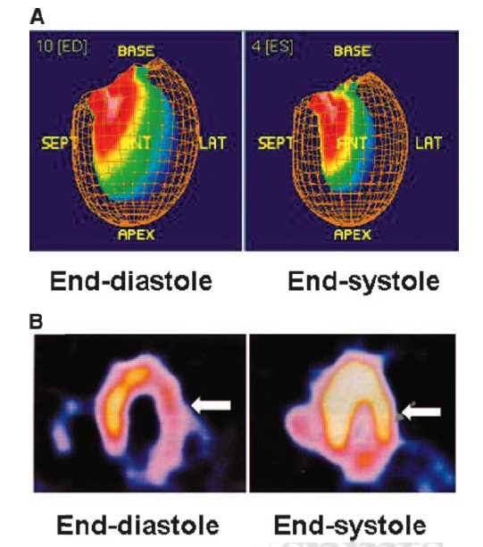
Ventricular function:
Wall motion and wall thickening
Regional Wall Motion
Regional Wall Thickening
Notes:
RWM is assessed by evaluating the endocardial border excursion and SWT is assessed by
Evaluating the changes in brightness (count intensity) from the end-diastolic to the end-systolic frame.
QGS offer automatic quantitative indices of RWM (in mm) and SWT (% diastolic thickness), which are displayed on a segmental, circumferential model of the LV

Slide 47
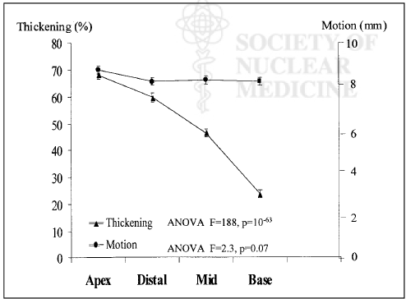
Regional ventricular function
Regional Wall Thickening
Longitudinal (apex-to-base) variability in systolic thickening

Slide 48
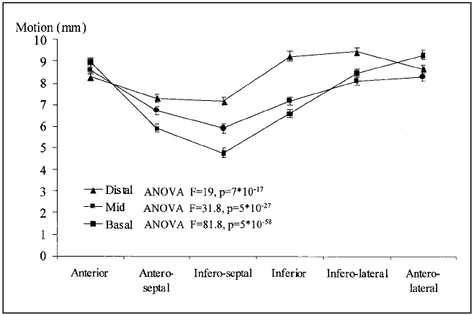
Regional ventricular function
Regional Wall Motion
Circumferential heterogeneity in endocardial motion

Slide 49
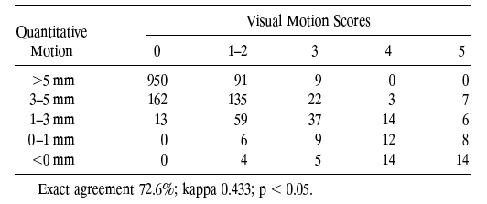
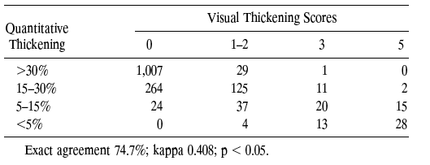
Image analysis: visual and quantitative analysis

Slide 50
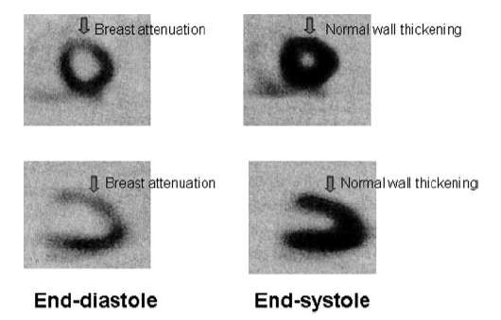
Gated SPECT: preserved SWT

Slide 51
GATED SPECT:
Measurement and Analysis
Quantification
  Regional myocardial perfusion and function
  LV systolic function
  LV diastolic function
  Cardiac geometry

Slide 52
Left Ventricular Systolic Function
In gated blood-pool studies, ejection fractions are derived as ratios of left ventricular cavity counts or volumes at end-diastole and end-systole
In gated perfusion studies, there is no activity in the blood pool, and ejection fractions can only be derived from the left ventricular cavity volumes EDV (at end-diastole) and ESV (at end-systole)

Slide 53
Gated-SPECT algorithm
The algorithm estimates and dysplays endocardial and epicardial surfaces for all gating intervals in the cardiac cycle, calculates the relative left ventricular cavity volumes and derives the global EF from the end-diastolic and end-systoliuc volume, all without operator interaction
EDV-ESV
ESV
EF =

Slide 54
GATED SPECT (QGS)
Lower limit of normal (mean minus 2 SD) for ejection fraction (EF):
    50% women
    43% men

Slide 55
GATED SPECT (QGS)
Upper limit of normal (mean plus 2 SD) for end-diastolic volume (EDV):
    91 ml women
    119 ml men
Upper limit of normal (mean plus 2 SD) for end-sistolic volume (ESV):
    40 ml women
    55 ml men

Slide 56
GATED SPECT:
Measurement and Analysis
Quantification
  Regional myocardial perfusion and function
  LV systolic function
  LV diastolic function
  Cardiac geometry

Slide 57
Left Ventricular Diastolic Function
PER Peak Emptying Rate
PFR Peak Filling Rate
PFR2 Peak Secondary Filling Rate
MFR/3 Mean filling rate during the first third of diastolic time
PER and PFR were defined as minimum and maximum dV/dt values divided by the end-diastolic volume ( /s)
MFR/3 was defined as the average dV/dt value during the first third of the diastolic time ( /t)

Slide 58
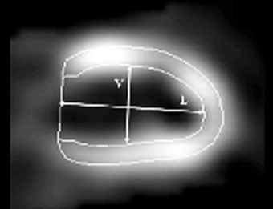
Quantitative gated-SPECT algorithm on end-diastolic long-axis images
Sphericity index
Ratio of the LV long axis to the LV vertical diameter with overlaid endocardial and epicardial contours

Slide 59
Quantification of SPECT Current approaches
Alberto Cuocolo
Department of Biomorphological and Functional Sciences
University Federico II, Napoli, Italy

Slide 60
Gated SPECT Quantification
Measurable LV parameters
Regional perfusion
Ejection fraction
Wall motion and wall thickening
End-diastolic and end-systolic volumes
Systolic and diastolic functional indexes

Slide 61
Gated SPECT Quantification
QGS (Cedars-Sinai) Germano et al. J Nucl Med 1995
SPECTEF (St. Luke’s) Nichols et al. J Nucl Cardiol 1996
EGS (Emory U.) Faber et al. J Nucl Med 1999
4D-MSPECT (U. Michigan) Ficaro et al. Circulation 1999 (abst)
Multidim (Stanford U.) Goris et al. Nucl Med Commun 1994
Yale CQ (Yale U.) Lam et al. J Nucl Med 2001 (abst)
----- (U. Chicago) Williams et al. J Am Coll Cardiol 1996
----- (U. Virginia) Smith et al. J Nucl Cardiol 1997

Slide 62
Gated SPECT Quantification
Commercially available software
QGS (Cedars-Sinai) Germano et al. J Nucl Med 1995
Emory Toolbox (Emory U.) Faber et al. J Nucl Med 1999
4D-MSPECT (U. Michigan) Ficaro et al. Circulation 1999
Multidim (Stanford U.) Goris et al. Nucl Med Comm 1994
Yale CQ (Yale U.) Lam et al. J Nucl Med 2001

Slide 63
Myocardial perfusion
Absolute quantification of myocardial perfusion is not possible with SPECT
Quantitative analysis of relative perfusion distribution is available and adds useful information, improving both reliability and reproducibility of interpretations
Programs for quantitative analysis have been developed and validated
Quantitative analysis should be used as a supplement to the visual review of the images
Technical problems and most artifacts will not be recognized, if only quantitative analysis is performed
Notes:
True quantification of regional, myocardial perfusion is possible with PET, but not with SPET, although several attempts are underway to create such programs for SPET.
Quantitative analysis of relative perfusion distribution and myocardial function is available and adds useful information including prognostic information, improving both reliability and reproducibility of interpretations.
A number of programs for quantitative analysis have been validated.
It is, however, important to emphasize that the quantitative analysis should be used as a supplement to the visual review of the images and should not be reported isolated from the review of the images.
Technical problems and most artifacts will not be recognized, if only quantitative analysis is performed.

Slide 64
Perfusion defects
Segmental models
One approach to quantify myocardial perfusion images is to first divide the myocardium into a number of segments
Each segment is scored separately using a 5-point model ranging from 0 (normal uptake) to 4 (uptake absent)
The total score of the left ventricle is referred to as the Summed Stress Score (SSS), Summed Rest Score (SRS), and Summed Difference Score (SDS)
Notes:
There are several programs that highlight regions with “significantly” reduced tracer uptake and quantify the extent and severity of perfusion defects. This type of analysis is based on a database comprising a reference population, often a combination of subjects with low likelihood of coronary artery disease or normal coronary angiography and patients with known coronary artery disease. There are many parameters that potentially may influence the myocardial perfusion images for example gender, tracer, acquisition and processing protocols, patient position, and attenuation compensation. Both the size of the database and similarity with the parameters, just mentioned, of the patient population examined locally are important for a reliable analysis. This is, however, not always available and the physician should be aware of this limitation as well as the fact that small activity defects are often found also in healthy subjects.
Segmental models.
One approach to quantify myocardial perfusion images is to first divide the myocardium into a number of segments, e.g 17 segments. Each segment is scored separately using a 5-point model ranging from 0 (normal uptake) to 4 (uptake absent).
The total score of the left ventricle is referred to as the Summed Stress Score (SSS), Summed Rest Score (SRS), and Summed Difference Score (SDS). All scores have been shown to be of prognostic value.

Slide 65
Standardized myocardial segmentation for SPECT imaging of the heart
AHA Scientific Statement. Circulation 2002

Slide 66
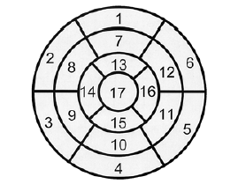

Standardized segmentation for SPECT imaging
AHA Scientific Statement. Circulation 2002

Slide 67
Image analysis
Segmental visual scoring of tracer activity
0 = normal tracer uptake
1 = mild reduction of tracer uptake
2 = moderate reduction of tracer uptake
3 = severe reduction of tracer uptake
4 = absent tracer uptake

Slide 68
Variables incorporating the extent and severity of perfusion defects
Summed stress score (ischemia + scar)
  Sum of all segmental stress scores
Summed rest score (scar)
  Sum of all segmental rest scores
Summed difference score (ischemia)
  Sum of differences between stress and rest scores

Slide 69
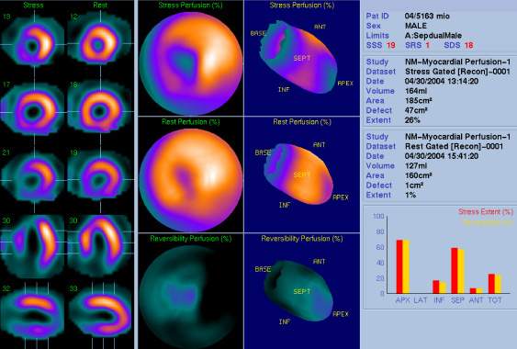
Quantitative Perfusion SPECT (QPS)

Slide 70
Summed stress score
Normal
  SSS ≤3 (0-4% of abnormal myocardium)
Mildly abnormal
  SSS 4-7 (5-10% of abnormal myocardium)
Moderately abnormal
  SSS 8-10 (11-15% of abnormal myocardium)
Severely abnormal
  SSS >10 (≥16% of the abnormal myocardium)

Slide 71
Reproducibility of quantitative analysis of cardiac SPECT imaging
Acampa et al. J Nucl Cardiol 2000

Slide 72
Myocardial perfusion imaging
Agreement in interpretation between core laboratory and individual investigators in a multicenter trial

Slide 73
Perfusion defects
Coronary artery supply and SPECT images
Some quantitative analysis programs assign myocardial segments to a specific vascular territory
There is a large inter-individual variability in the territories subtended by the three main coronary arteries and their branches
Programs that allow matching of the angiographic and perfusion data within one person are not commercially available yet
Notes:
Coronary artery supply and SPET images. Some quantitative analysis programs may give the option to assign myocardial segments to a specific vascular territory.
One has to bear in mind, however, that there is a large inter-individual variability in the territories subtended by the three main coronary arteries and their branches. Programs that allow matching of the angiographic data and perfusion data within one person are not commercially available yet.
Until then one has to be careful assigning myocardial segments to specific vascular territories.

Slide 74
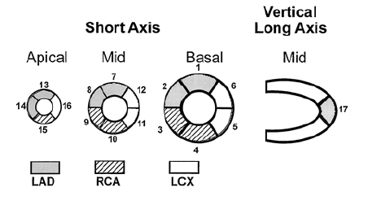
Coronary Artery Territories
AHA Scientific Statement. Circulation 2002

Slide 75
Perfusion defects
Pixel and voxel based models (polar maps and 3-D analysis )
Quantitative analysis performed on pixels (or voxels) with relative count values below reference limits (highlighted as black-outs)
Nnumber of pixels (or voxels) in the vascular territories are calculated to quantify the extent of perfusion defects
Notes:
Pixel and voxel based models.
A quantitative analysis can be performed of the polar maps.
Pixels with relative count values below reference limits are highlighted as black-outs.
The number of pixels in the different vascular territories are calculated to give a quantification of the extent of a perfusion defects. There are also programs that use a three-dimensional analysis instead of the polar maps. In these programs abnormal voxels are highlighted in the display and the quantification of the perfusion defects are performed in a similar way.

Slide 76
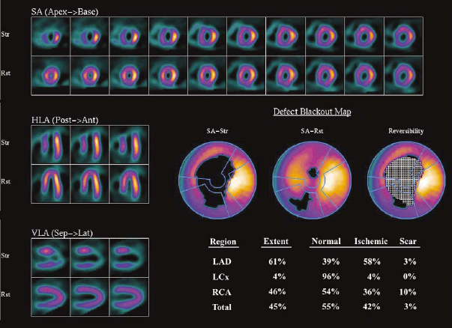
Sestamibi stress–rest myocardial perfusion SPECT
4D-MSPECT (University of Michigan)
Ficaro and Corbett, J Nucl Cardiol 2004
Notes:
Quantification software provides the blackout polar maps and regional and
global defect extent values for each vascular territory.
By use of the reversibility data, the regional defect extent values are classified as ischemic and scar.

Slide 77
Prognostic variables on perfusion imaging predictive of future cardiac events
Large defect size (>20% of the LV)
Defects in >1 coronary vascular territory (suggesting multivessel CAD)
Defect reversibility (reflective of inducible ischemia)
Large number of nonreversible defects
Transient or persistent LV cavity dilation
Increased lung uptake of the tracer
Resting LV ejection fraction on gated SPECT <40%

Slide 78
Transient LV cavity dilatation
Transient LV cavity dilatation during stress is a marker of coronary artery disease and an independent predictor of cardiac events
Automatic assessment of the transient ischemic dilation ratio is included in many of the software packages
It can be used as a complement to a qualitative assessment of the cavity size in the rest and stress images
Notes:
Transient left ventricular cavity dilatation (TID) during stress has shown to be a marker of coronary artery disease and an independent predictor of cardiac events
Automatic assessment of the transient ischemic dilation ratio is included in many of the software packages and this can be used as a complement to a qualitative assessment of the cavity size in the rest and stress images

Slide 79
LV volumes and function
There are several commercially available programs for analysis of gated studies
EDV, ESV, EF, regional WM and WT are generally presented by these programs
The results are based on computer-derived endocardial and epicardial edges
The accuracy of volume calculations have been well validated with MRI and contrast ventriculography as gold standards
The accuracy of regional WM and WT is less well validated and reference values are limited
Notes:
There are several, commercially available programs for analysis of gated studies
Left ventricular end-diastolic volume, end-systolic volume, ejection fraction, regional wall motion and wall thickening are generally presented by these programs
The results are based on computer-derived endocardial and epicardial edges
They should be reviewed for edge detection errors. Common sources for detection errors are: large myocardial perfusion defects, extra-cardiac activity, small left ventricles, left ventricular hypertrophy and images with low counts
The accuracy of volume calculations have been well validated with MRI and contrast
ventriculography as gold standards for Tc-99m labelled tracers, and to some degree also for Tl-201, which is less accurate for this purpose
The accuracy of regional, systolic wall motion and thickening is less well validated and reference values limited

Slide 80
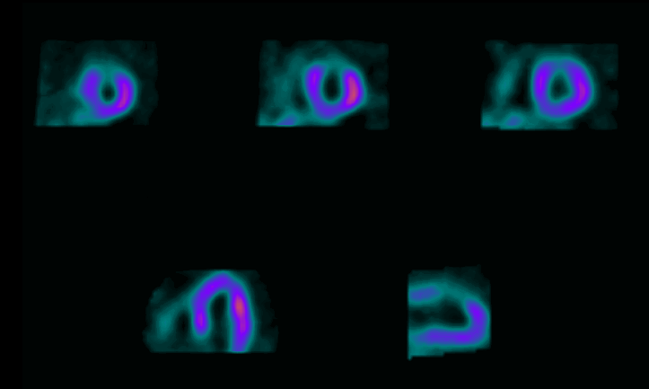
Myocardial Perfusion Gated SPECT Scan
Notes:
The gated portion of the SPECT study allows both the visual and quantitative assessment of left ventricular function. These measures include left ventricular ejection fraction and end-diastolic and end-systolic volumes. In addition, this modality achieves excellent visualization of both the endocardial and epicardial surfaces, allowing for the evaluation of left ventricular wall motion and wall thickening.
In this scan, the top row represents 3 short axis images (apical, mid, and basal short-axis slices) and the bottom row represents the mid, horizontal, and vertical long-axis slices.

Slide 81
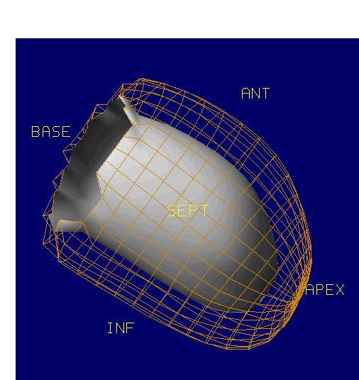
3-D Image of Left Ventricular Surfaces
Notes:
This slide represents computer-rendered, 3-dimensional left ventricular surfaces. From these surfaces, a volumetric calculation of left ventricular ejection fraction is made [LVEF = (EDV – ESV)/EDV].
It is important to recognize that this computer-rendered image is based on the epicardial and endocardial surfaces chosen by the computer program. Thus, this image should only be used to evaluate left ventricular wall motion, wall thickening, and ejection fraction after the surface contours have been visually verified.
In this image, the grid or cage represents the left ventricular
epicardial surface and the gray surface represents the left
ventricular endocardial surface.

Slide 82
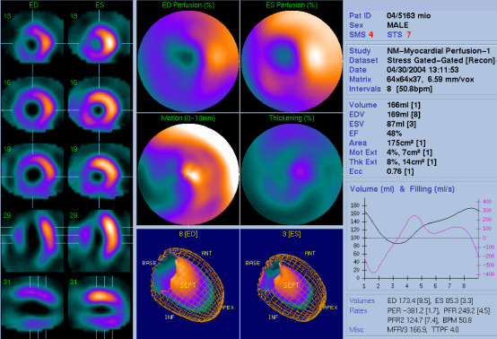
Quantitative Gated SPECT (QGS)

Slide 83
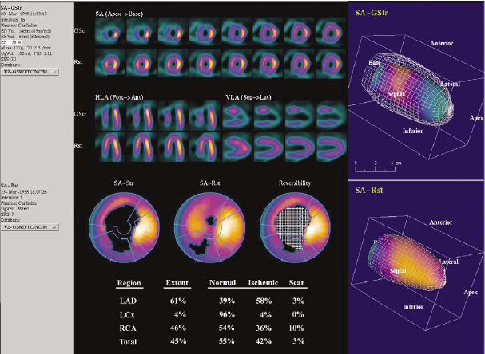
Sestamibi stress–rest myocardial perfusion SPECT
4D-MSPECT (University of Michigan)
Ficaro and Corbett, J Nucl Cardiol 2004
Notes:
Gated stress (GStr)–ungated rest (Rst) myocardial perfusion SPECT images from a 2-day Tc-99m sestamibi protocol.
Quantification perfusion maps provide regional defect extent values and classification (normal, ischemia, scar).
Cine review of 3D-rendered images provides visual assessment of LV motion and thickening.
Volumetric data (EF, volumes, mass, transient ischemic dilatation (TID)) quantified from the gated stress images are presented in the panel on the left.

Slide 84
Validation of Gated SPECT LVEF
Linear relation coefficients vs reference techniques (Echo, MRI, RNA, Angio)
Notes:
Several software are commercially available for the quantitative analysis of gated-SPECT acquisitions.
QGS (Cedars-Sinai) Germano et al., JNM 1995;36:2138
Emory Toolbox (Emory U.) Faber et al., JNM 1999;40:650
4D-MSPECT (U. Michigan) Ficaro et al., Circulation 1999
Multidim (Stanford U.) Goris et al., Nucl Med Commun 1994
Yale CQ (Yale U.) Lam et al., J Nucl Med 2001
The left ventricular ejection fraction value provided by the quantitative analysis of gated-SPECT with the different software, have been evaluated by comparison with other imaging modalities in several studies (echo, MUGA, contrast ventriculography, 1st pass, MRI). The average linear correlation coefficient for the different packages is reported.

Slide 85
Validation of Gated SPECT LV Volumes
Linear relation coefficients vs reference techniques (Echo, MRI, RNA, Angio)
Notes:
Left ventricular volumes were also validated by comparison with reference imaging modalities.
The average linear correlation coefficient are reported for QGS and non-QGS softwares.

Slide 86
Gated SPECT measurements are algorithm-dependent
p<0.01
p<0.01
p<0.01
Notes:
It is important to keep in mind that the different softwares provide different values for LV EF and volumes, because each method has unique characteristics that depend on its specific algorithm and thus behaves differently in the various patient subgroups.
Therefore, the methods should not be used interchangebly. Because implementation of methods may vary from one institution to another, the ideal mechanism for calibrating one of newer gated-SPECT methods versus an established technique is to perform an internal validation specific for that institution.

Slide 87
Influence of tracer, gender and camera on LV EF
*p<0.001
Males vs Females
Ababneh et al. J Nucl Cardiol 2000

Slide 88
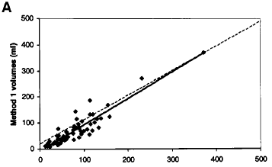
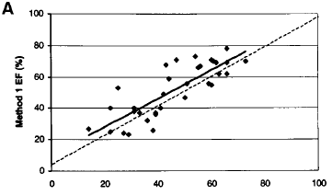
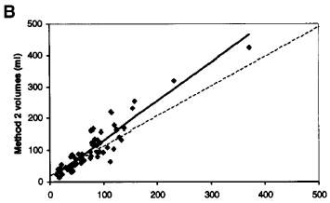
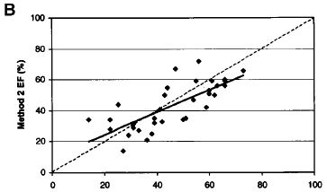
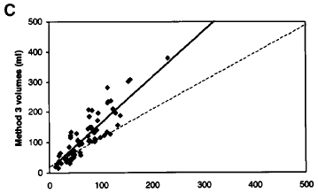
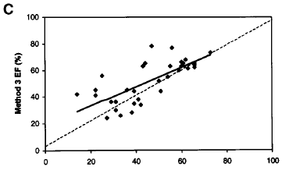
Validation of Gated SPECT Measurements
LV Volumes
LV Ejection Fraction
Method 1
SPECTEF
Method 2
QGS
Gated SPECT
Gated SPECT
Method 3
Toolbox
Echocadiography
Nichols et al. J Nucl Med 2000
Echocadiography
Notes:
Echocardiographic volumes were determined in 33 subjects with coronary artery disease using the modified Simpson’s rule technique applied to digitized apical 4-chamber and apical 2-chamber views of 4 averaged heartbeats. These volumes were compared with those from 3 gated SPECT methods based on Simpson’s rule LV modeling similar to standard echocardiographic algorithms (SPECT EF from St. Luke’s-Roosevelt Hospital) (method 1), Gaussian myocardial count profile curve fitting (QGS from Cedars-Sinai Medical Center) (method 2), and an endocardial model based on perfusion sampling and count-based thickening (Cardiac Toolbox from Emory University).
Although all gated parameters correlated well with the echographic data, QGS tends to give costant LVEF values above a large range of LV volumes when compared to echo, with a small underestimation (± 3-4% Units) in large LV and an overestimation in small LV. The other two algorithms tend to give different LVEF values, in comparison to echo, with the increase in the LV volumes.

Slide 89
QGS post-stress LV ejection fraction and volumes
Normal values (8-frame gating with Tc-99m agents)
Sex EF EDV ESV
Sharir et al. (1999) M+F 45% 120 ml 70 ml
Ababneh et al. (2000) F 50% 91 ml 40 ml
M 43% 119 ml 55 ml
Sharir et al. (2002) F 50% 100 ml 42 ml
M 45% 142 ml 65 ml
Notes:
In the slide are reported the normal limits for LVEF and volumes obtained with QGS algorithm in different reports.

Slide 90
Limitations of LVEF and volume measurements
Physiologically “high” LV ejection fraction values in patients with small hearts
Lower LV ejection fraction values with 8-frame gating
Possible “cutting-off” of aneurysms
Possible lower LV ejection fraction values in LVH patients

Slide 91
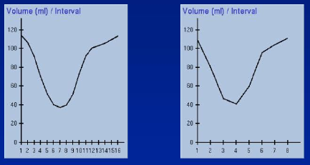
LVEF measurement: 8- vs 16-frame gating
16-frame
8-frame
EDV = 114 ml
ESV = 37 ml
LVEF = 68%
EDV = 111 ml
ESV = 41 ml
LVEF = 63%

Slide 92
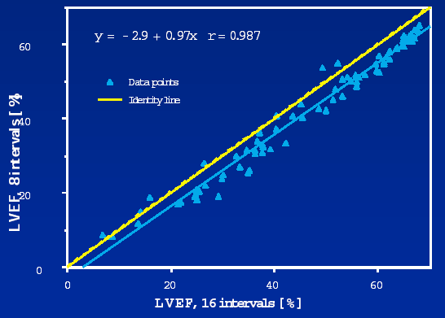
LVEF measurement: 8- vs 16-frame gating
8-frame gating causes a systematic 3-4% decrease

Slide 93
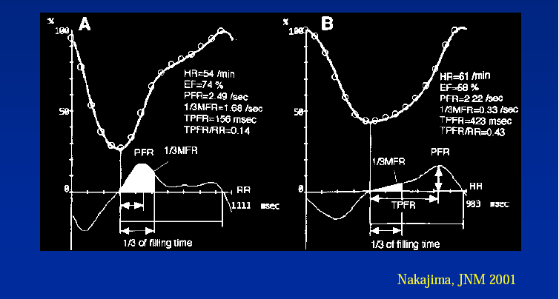
LV Diastolic Function by Gated SPECT
Notes:
If a gated-SPECT image with an adequate number of frames per cardiac cycle (suggested 32 frames) is performed, in addiction to volumes and ejection fraction values, the diastolic function may be also evaluated.

Slide 94
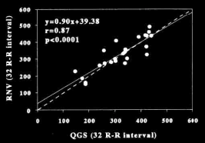
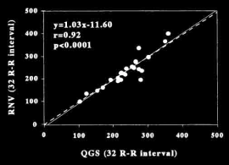
Systolic and diastolic LV function by 32-frame QGS
Peak Ejection Rate
Peak Filling Rate
Kikkawa et al. Eur J Nucl Med 2001
Notes:
Systolic and diastolic function parameters obtained by 32 frames gated-SPECT are well correlated with data from radionuclide ventriculography, assumed as the reference technique. (Kikkawa, EJNM 2001.).
In a more recente paper, it was documented that in patients with chest pain and previous infarction , the values for PER, and PFR were lower after stress than at rest; in addiction, the time to PFR was significantly prolonged in patients with infarction after stress. Thus, modified QGS software and a 32-frame acquisition may be used to assess poststress systolic and diastolic dysfunction at 30 minutes after exercise. (Sakamoto et al. J Nucl Cardiol 2004;11:152-8.)

Slide 95
“Normal” function is not spatially uniform
For example
The septum moves less than lateral wall in most normal subjects
The apex thickens more than the base in most normal subjects

Slide 96
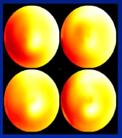
Normal myocardial wall motion pattern
Males
Post-stress
Sestamibi
Males
Rest
Tl-201
Females
Post-stress
Sestamibi
Females
Rest
Tl-201

Slide 97
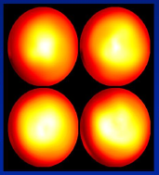
Normal myocardial wall thickening pattern
Males
Post-stress
Sestamibi
Males
Rest
Tl-201
Females
Post-stress
Sestamibi
Females
Rest
Tl-201

Slide 98
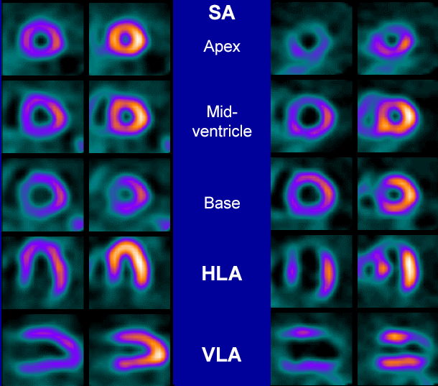
Myocardial wall thickening patterns
ED
ES
ED
ES
Normal
Anterior MI

Slide 99
Increase in diagnostic confidence by gated SPECT
Notes:
The addition of the analysis of ECG-gated images to the reading of stress-rest perfusion images alone, reulsted in shifting the final scan interpretation to a more normal class in patients with a low pre-test likelihood of CAD, and to a more abnormal class in patients with high pre-test or known CAD. The number of borderline “normal” or “abnormal” interpretations significantly reduced when gated images are interpreted simultaneously with stress and rest perfusion images.

Slide 100
Increased Specificity for CAD Detection in Women by Gated-SPECT
Diagnostic Accuracy in 115 Women
Notes:
Taillefer et al, compared the diagnostic accuracy of Thallium-201, Sestamibi SPECT and gated-SPECT in a group of 115 with suspected CAD.
They documented that in the identification of stenosis > 70% sestamibi was better than thallium-201, and that with gated-SPECT a further increase in accuracy was obtained. The increase in specificity was obtained without a concomitant decrease in sensitivity (84% with thallium-201 and 80% with sestamibi).

Slide 101
Differentiating artifacts from true perfusion defects
Reversible defects
  Usually assumed to be true perfusion defects
Fixed Defects
  Normal thickening on gated images: artifacts
  Hypokinesis with decreased thickening: true perfusion defects

Slide 102
Differentiating artifacts from true perfusion defects
Quantitative analysis
Compares patient data to gender matched regional count densities
Does not take into account vast differences in body habitus
May decrease specificity by identifying artifacts as true perfusion defects
Prone images
Inferior defects present on supine but absent on prone images are most likely artifacts

Slide 103
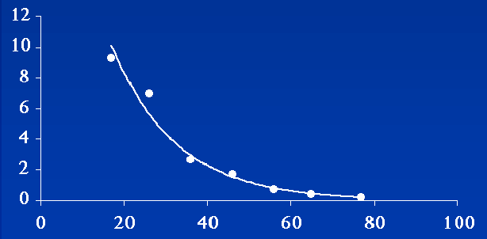
Prognostic value of gated SPECT LVEF
2,686 consecutive patients with known or suspected CAD
Cardiac death (%/y)
LV ejection fraction%
Sharir et al. J Nucl Med 2001
Notes:
Perfusion data reflect the condition at the time of tracer injection (at rest or during stress) whereas the functional, gated SPECT data represent images of the LV
myocardium during the acquisition, i.e. generally under rest conditions. It should be noted that although the functional gated SPECT acquired after stress show the
LV at rest, it may sometimes represent a different physiological state: if a patient is injected at the time of stress-induced ischaemia, transient wall motion abnormality and possibly dilated LV and reduced EF – myocardial stunning - may persist and be observed during the acquisition phase, up to 90 minutes or even later after the resolution of ischaemia. Detection of post-stress myocardial stunning by means of gated-SPECT may contain independent, important information about the LV, useful for both diagnostic and prognostic assessments. Gated 201Tl studies can be performed, but the documentation of the accuracy and reliability is less than for the 99mTc-labelled tracers.

Slide 104
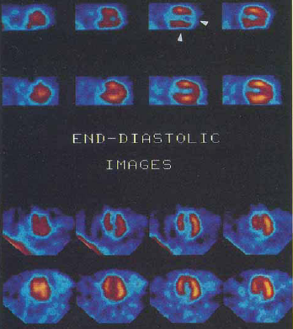
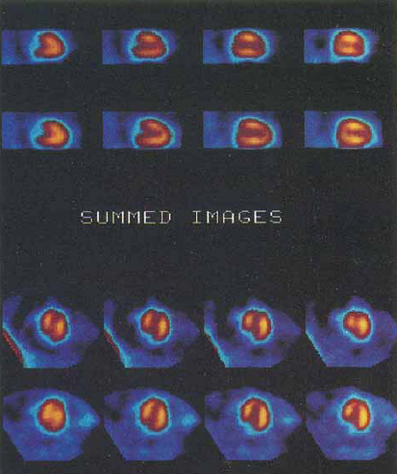
LV Perfusion in End-diastolic Frame
End-diastolic Images
Summed Images
From Taillefer et al. J Nucl Cardiol 1999
Notes:
From ECG-gated SPECT, end-diastolic images can be easily derived. This may reduce the effect of wall thickening during systole and potentially improve the sensitivity of myocardial perfusion imaging, particularly in patients with small hearts. This hypothesis was tested by Taillefer et al in a group of 53 female patients, comparing the accuracy of end-diastolic images with standard summed perfusion images. Although a non significant trend toward and improved sensitivity in comparison with standard summed images, end-diastolic images showed more ischemic defects. Thus, the analysis of end-diastolic images may be useful adjunct to the analysis of standard perfusion images in patients with small hearts.

Slide 105
Conclusions
Assessment of LV volumes and ejection fraction
  correlated with other imaging modalities
Increases the specificity
  particularly in women and obese patients
Reduces the number of borderline interpretation
Functional data provides incremental information
Assessment of systolic and diastolic functional indexes
  high framing rate acquisition (32 fr/cycle)
  correlated with data by RNA

