Slide 1
OVARIAN CANCER: BRCA MUTATION AND BEYOND
19 Dicembre 2022, Padova
Giulia Tasca
U.O:C. Oncologia 2
Istituto Oncologico Veneto IRCCS Padova

Slide 2
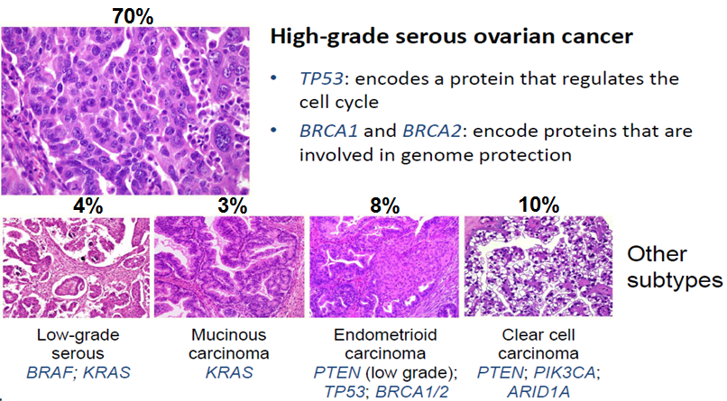
CLASSIFICAZIONE ISTOGENETICA DELLE NEOPLASIE OVARICHE
Neoplasie epiteliali (90%)
Tumori sierosi
Tumori mucinosi
Tumori endometriali
Tumori a cellule chiare
Tumori di Brenner
Carcinomi indifferenziati
Neoplasie germinali (5%)
Disgerminoma
Carcinoma embrionale
Tumori del seno endodermico
Coriocarcinoma
Gonadoblastoma
Carcinoma extraembrionale
Teratoma maturo
Teratoma immaturo
Neoplasie di origine dallo stroma gonadico (4%)
Tumori della granulosa e della teca
Tumori del Sertoli-Leydig
Ginandroblastoma
Mesenchima ovarico non specifico
Fibroma, leiomioma, lipoma
Linfoma
Sarcoma

Slide 4
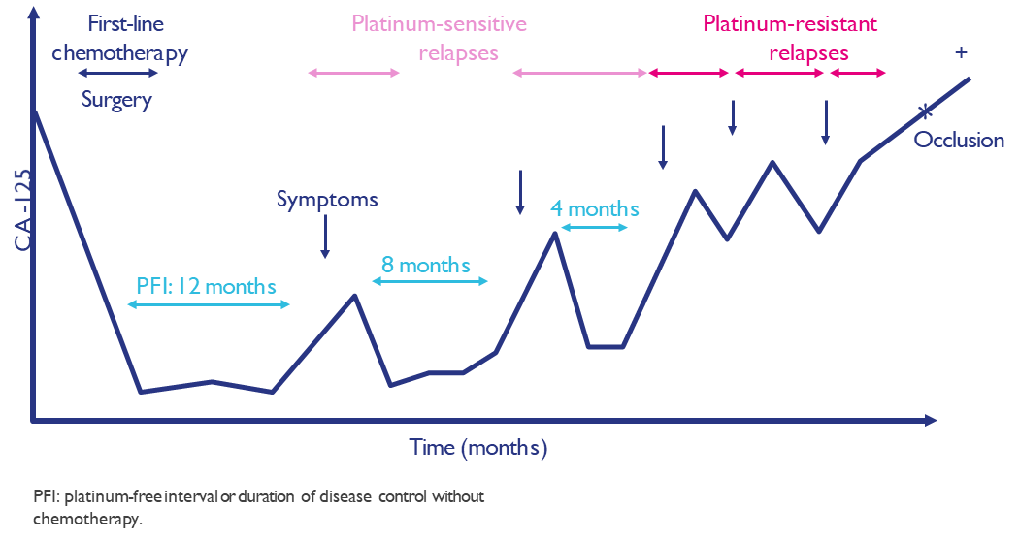
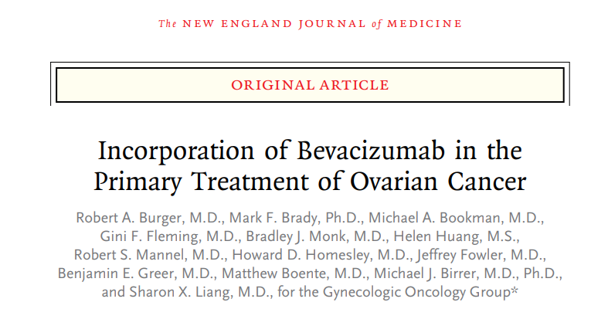
STANDARD OF CARE – PRIMA LINEA…until 2020
Cytoreductive surgery
Platinum- based chemotherapy
Maintenance therapy
Benefit in PFS, mainly in the HIGH RISK SUBGROUP
!!Selection of patients based on clinical features!!
Notes:
Oggi in particolare parleremo di quella che è la prima linea di trattamento
I cardini del trattamento di prima linea sono: la chirurgia, primaria o di intervallo. La chemioterapia con Carboplatino e Paclitaxel e ultima ma non meno importante le terapia di mantenimento in risposta a platino
Fino a pochi anni fa l’unica terapia di mantenimento proponibile era il Bevacizumab, con il limite importante che nonostante un chiare beneficio in PFS negli studi di approvazione il vantaggio in OS nella popolazione ITT non era stato dimostrato, se non da quest’analisi di sottogruppo, nel gruppo di pazienti definite ad alto rischio sulla base di caratteristiche cliniche (stadio, alto carico di malattia alla diagnosi, residuo post-chirurgico)
L’unmet need della patologia rimaneva dunque la necessità di trattamenti che effettivamente impattassero sulla sopravvivenza e la mancanza di trattamenti target, di medicina personalizzata

Slide 5
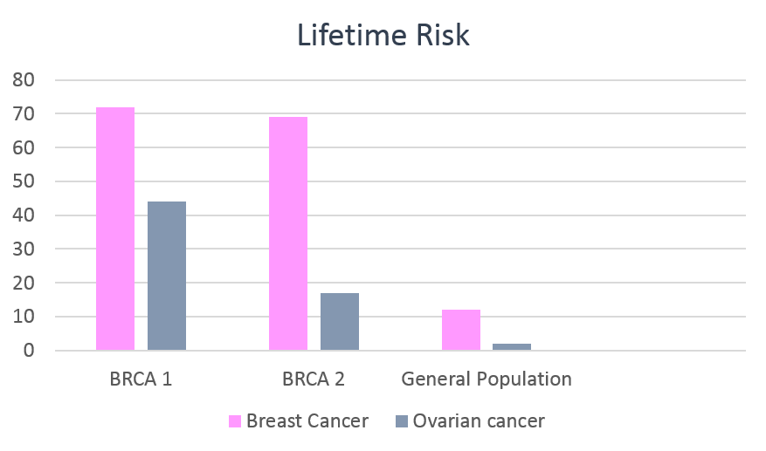
CARCINOMA OVARICO EPITELIALE – FATTORI DI RISCHIO
Age, older↑
Nulliparity↑
Early menarche↑
Late menopause↑
Obesity and use of talcum
Positive family history
Multiple pregnancies↓
Breast feeding↓
Oral contraceptives↓
BRCA-1 mutation →15%-45% OC risk (≤85% BC risk)
BRCA-2 mutation→10%-20% OC risk (≤85% BC risk)
72%
69%
44%
17%
12%
2%
Ledermann et al. Ann Oncol 2013; 24 (suppl.6)

Slide 6
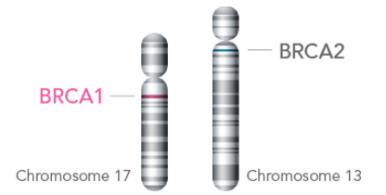
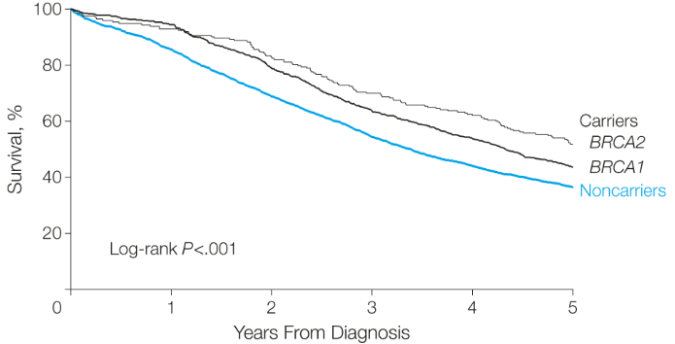
BRCA Genes
Involved in repairing DNA double-strand breaks through homologous recombination and in cell cycle control points;
In about 1 in 300-800 individuals (the prevalence varies between ethnic groups and geographic areas - "founder effect");
10-15% of OCs and 5-10% of BCs are due to BRCA1/2 mutations.
BRCA PHNENOTYPE: distinct clinical behaviour
Younger age
High grade
Serous Histology
Advanced stage
Visceral distribution of disease
High response to Platinum (and other non-Plt agents)
Better clinical Outcome
Bolton KL et al. JAMA 2012; Kuchenbaecker KB et al. JAMA 2017

Slide 7
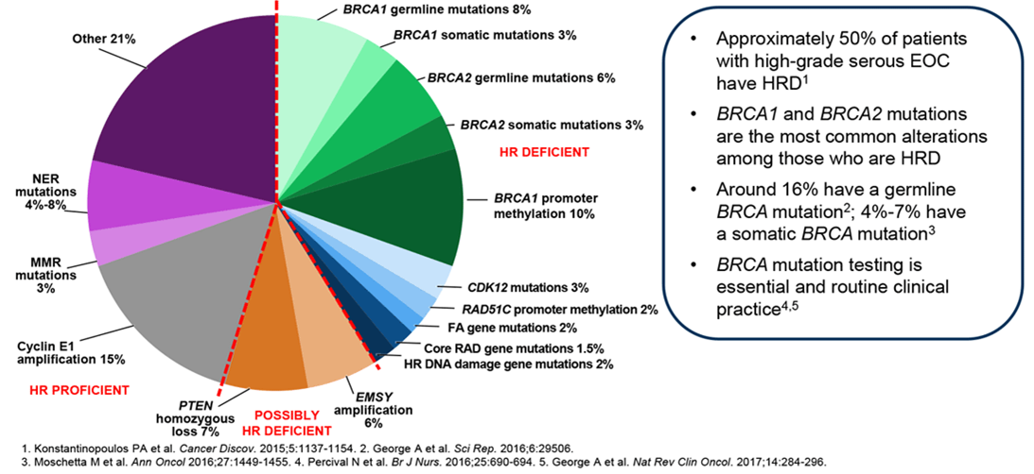
BEYOND BRCA MUTATIONS: BRCANESS TUMOURS & HOMOLOGOUS RECOMBINATION DEFICIENCY

Slide 8
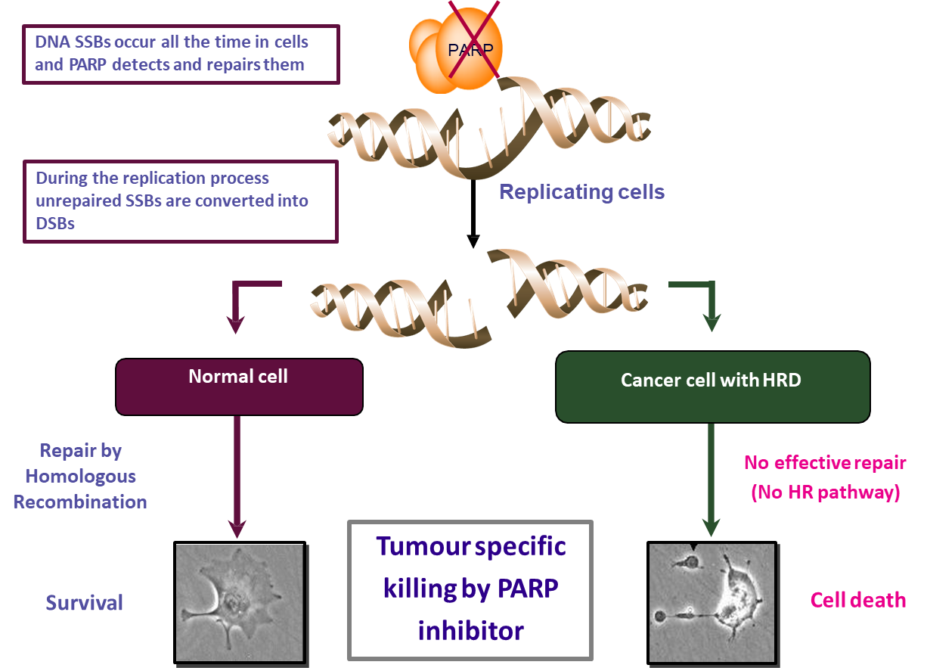
PARP INIBITORI (polyADP-ribose polimerase) E RIPARO DEL DNA
PARP is a key regulator of DNA damage repair processes
Involved in DNA base-excision repair (BER)
Binds directly to DNA damage
Produces large branched chains of polyADP-ribose
Attracts and assists BER repair effectors

Slide 9
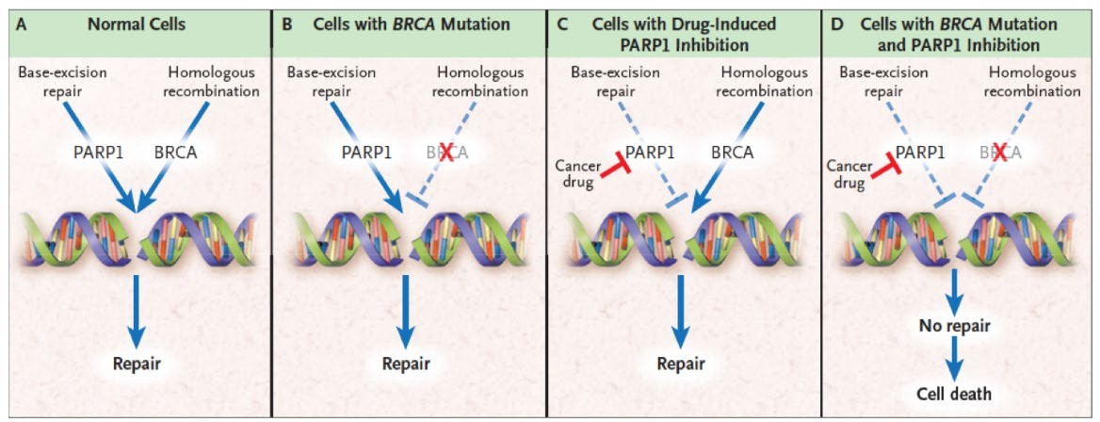
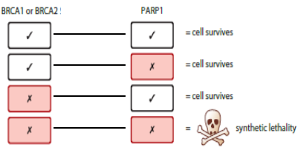
TARGETING BRCA MUTATED AND HR DEFICIENT CELLS/TUMOURS
DNA damage:
Single-strand breaks (SSBs)
Double-strand breaks (DSBs)
Various DNA repair mechanisms:
PARP enzymes are involved in SSBs repair via base excision repair→Unrepaired SSBs can lead to DSBs in dividing cells;
BRCA1/2 are involved in repair of DSBs via homologous recombination (HR)→ cells with defects on HR system can’t repair DSBs→cell death.
Iglehart JD ET AL, N EJM 2009

Slide 10
PARP INHIBITORS IN OVARIAN CANCER: OUTLINE OF STUDIES
Olaparib: maintenance treatment in first line (SOLO1)
maintenance treatment in combination with bevacizumab in first line (PAOLA-1)
maintenance treatment in ≥2° lines of therapies (Study 19 - SOLO2)
Niraparib: maintenance treatment in first line (PRIMA)
maintenance treatment in ≥2° lines of therapies (ENGOT-OV16 / NOVA)
Rucaparib: maintenance treatment in ≥2° lines of therapies (ARIEL3)
TRIAL | POPULATION | PFS with chemo alone
GOG218 | III R<0 o IV | 13 months
SOLO 1 | FIGO ≥III, BRCAm | 13.8 months
PRIMA | FIGO ≥III, HIGH RISK | 8.2 months
ATHENA | FIGO ≥III | 9.2 months
mPFS after 1^line chemotherapy
Moore K et al. NEJM 2018; Ray-Coquard I, et al. NEJM 2019; Ledermann J et al. NEJM 2012; Pujade-Lauraine E et al. Lancet Oncol. 2017; González-Martín A et al. NEJM 2019; Mirza MR et al. NEJM 2016; Monk BJ et al. JCO 2022

Slide 11
About our patient
Profile:
Female, PS sec ECOG 0
54 years old
Menopausal status for two years
1 pregnancy
Family history of cancer:
Paternal aunt with pancreatic cancer
Paternal aunt with pancreatic cancer + breast cancer
Past medical History:
Appendicectomy (in young age)
Medicaments:
None

Slide 12
Oncological history
Mar - Aug 2020
Sep 2020
2020
CT-Scan
mixed cystic solid tumor (11 cm×6 cm)
in the pelvic cavity + lymph nodes (the major, paraorthic of 11x6 mm)
Pathology report
High grade serous ovarian cancer
pT3c N1
(5/22 positive lymph nodes); - FIGO IIIC
Persistent abdominal pain
Sep 2020
Ca125
168.3 U/ml
17th Nov 2020
Gynecological examination revealed a large palpable, fixed, masses in the pelvic region (12*10*10cm)
Primary cytoreductive surgery –R0

Slide 13
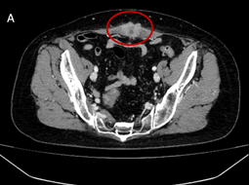
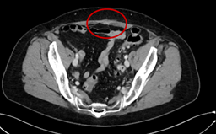
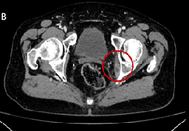
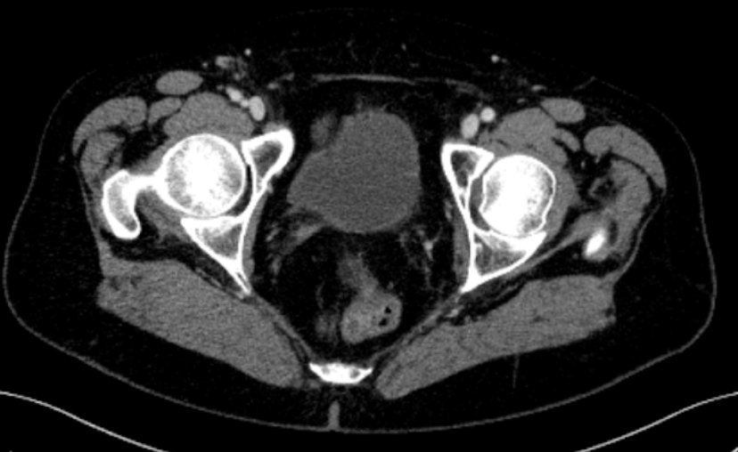
First line treatment (Chemotherapy)
17/01/2021
Carboplatin + Paclitaxel
Cycle 1
q3w
Cycle 2
Cycle 3
Cycle 4
Cycle 5
Cycle 6
Cycle 4
Cycle 5
Ca125
234 U/ml
Ca125
6 U/ml

Slide 14
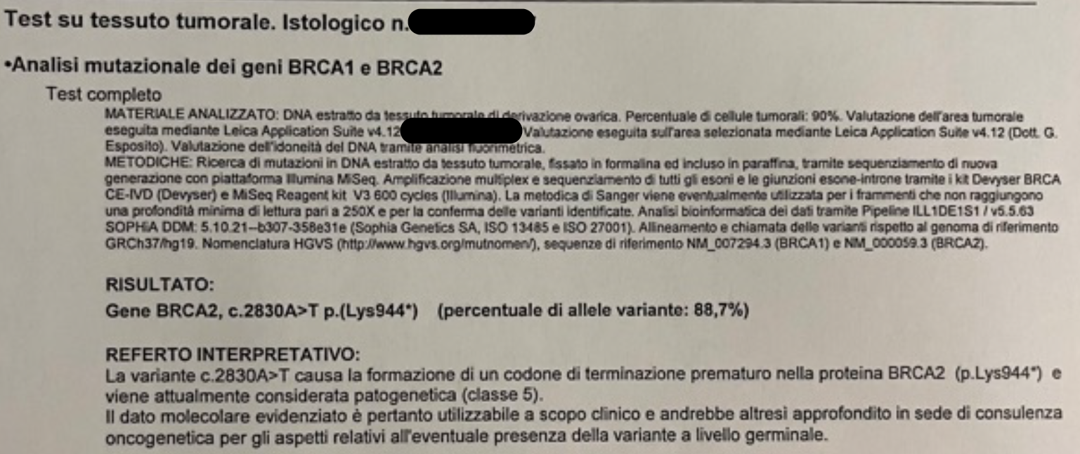
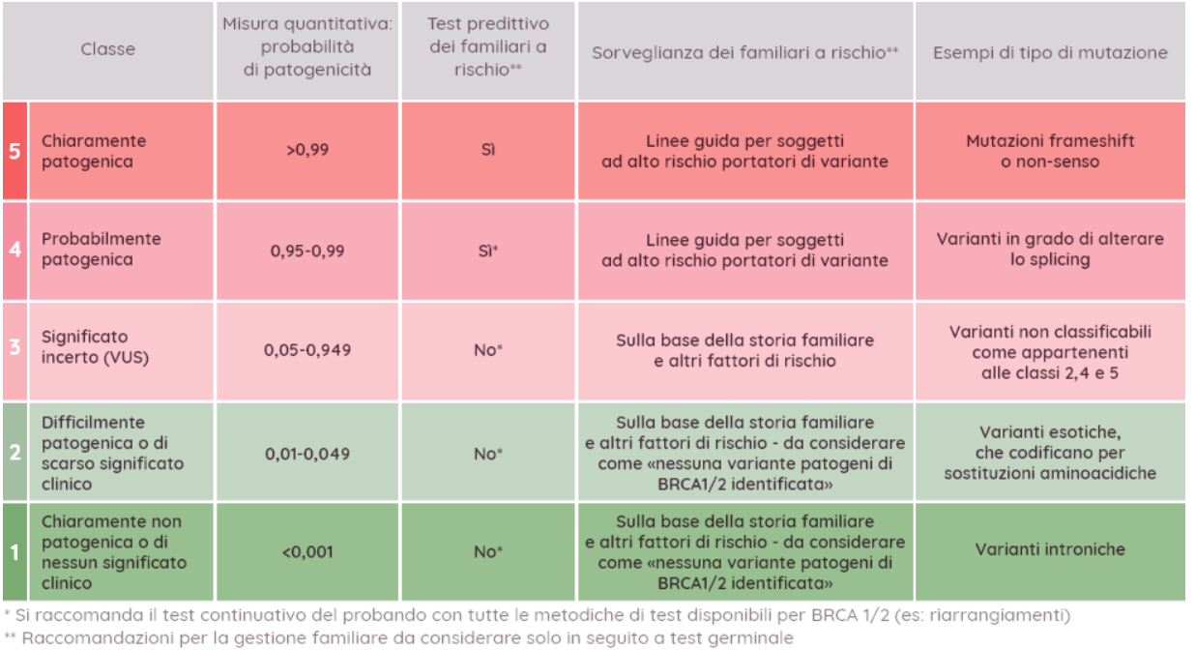

Slide 17
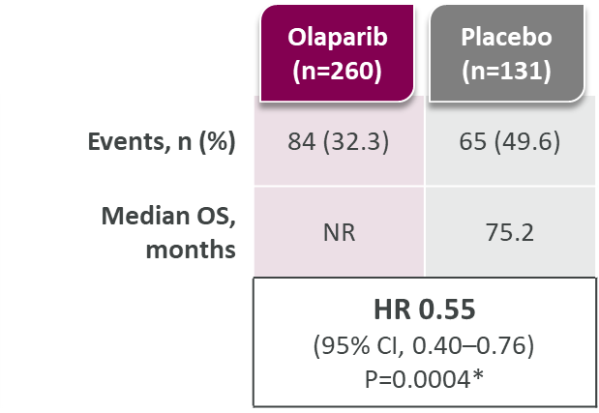
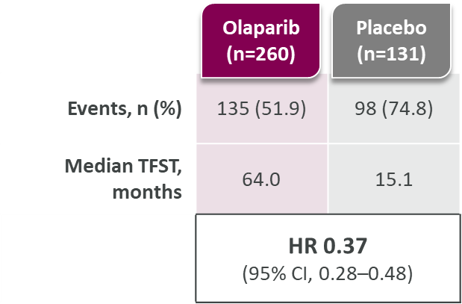
SOLO 1: 7-years Overall Survival
Time to First Subsequent Therapy
100
100
90
90
80
73.1%
80
70
67.0%
70
60
63.4%
Olaparib
60
51.2%
Overall survival (%)
Patients free from first subsequent
therapy or death (%)
45.3%
50
50
40
46.5%
40
Olaparib
30
Placebo
30
20
20
22.5%
20.6%
Placebo
10
10
0
0
6
12
18
24
30
36
42
48
54
60
66
72
78
84
90
96
102
0
0
6
12
18
24
30
36
42
48
54
60
66
72
78
84
90
96
102
No. at risk
Months since randomization
No. at risk
Months since randomization
Olaparib
260
252
246
236
227
214
203
194
185
177
170
165
159
157
153
79
21
0
Olaparib
260
240
223
203
190
160
147
141
132
125
119
115
111
102
75
31
5
0
Placebo
131
128
125
114
108
100
97
92
87
80
73
67
60
54
52
21
6
0
Placebo
131
114
79
55
45
39
32
28
26
25
25
24
24
23
18
4
1
0
44.3% of patients in the placebo group received subsequent PARP inhibitor therapy, compared with 14.6% of patients in the olaparib group
DiSilvestro P, et al. Presented at ESMO Congress 2022

Slide 18
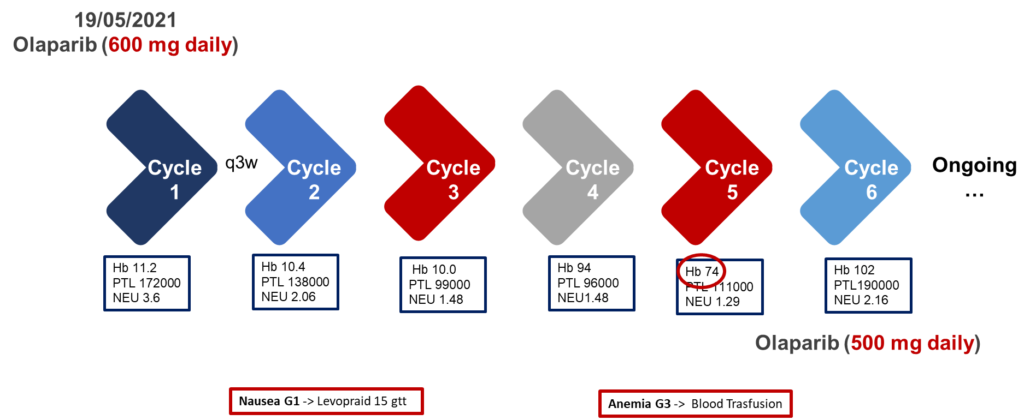
How we choose first line maintenance treatment?
Macroscopical residual disease after surgery: high risk patient;
PR to platinum-based CT with residual disease at the end of CT;
BRCA mutated;
Young patient with excellent performance status;
OLAPARIB

Slide 19
About our patient
Profile:
Female, PS sec ECOG 1
66 years old
Menopausal at 50 years old
3 pregnancies
Family history of cancer:
Father with gastric cancer and urotelial cancer
Past medical History:
Arterial hypertension, hypercholesterolemia, hypertriglyceridemia
Appendicectomy (in young age)
Endoscopic resection of uterine fibroma (2018)
Medicaments:
Nebivolol 5 mg, 1 cp/die
Rosuvastatina/Ezatimibe 10/10 mg, 1 cp/die

Slide 20
Oncological history
February 2021
February 2021
2022
Persistent abdominal discomfort with rapidly increase of abdominal volume
CT-Scan:
abdominal free fluid, multiple pelvic masses; multiple lombo-aortic adenopathies and omental cake.
E.I. High grade serous ovarian cancer.
Tissue test for BRCA1/2 mutation: negative.
Ca125
6440 U/ml
March 2021
explorative/diagnostic LPS

Slide 21
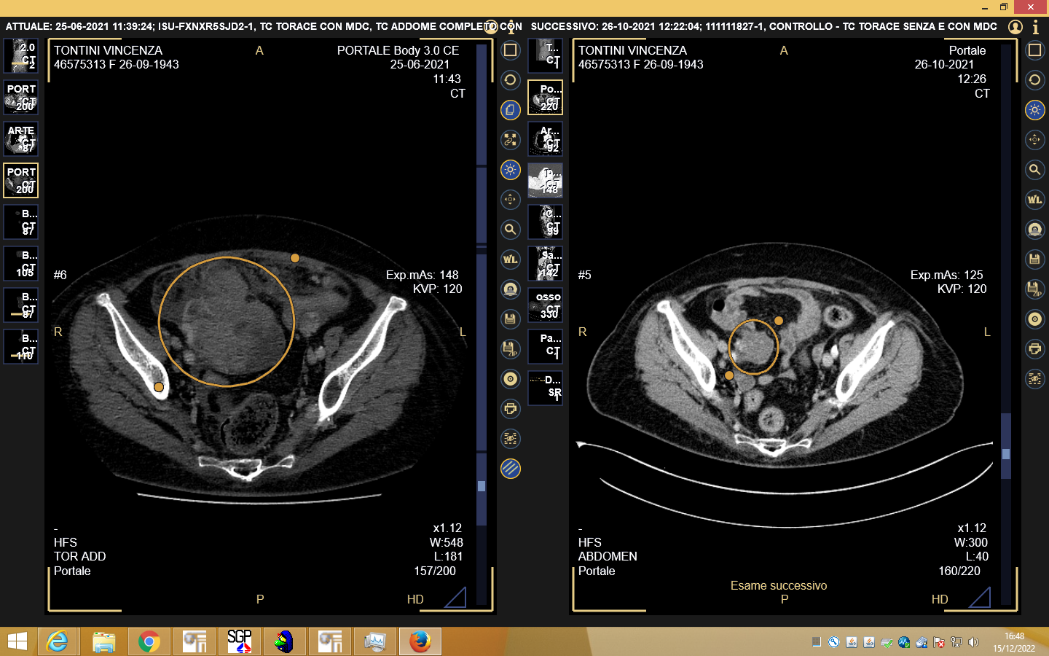
Oncological history
01/04/2021
Carboplatin + Paclitaxel
3rd June 2021
Interval debulking surgery, R0
Cycle 1
q3w
Cycle 2
Cycle 3
Cycle 4
Cycle 6
Ca125
830 U/ml
Ca125
220 U/ml
Cycle 4
Cycle 5
Cycle 6

Slide 22
Oncological history
Carboplatin + Paclitaxel
Cycle 4
Cycle 4
Cycle 4
Cycle 5
Cycle 5
Cycle 6
Ca125
45 U/ml
Ca125
6 U/ml
Ca125
11 U/ml

Slide 24
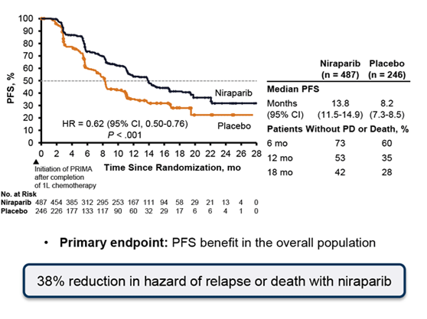

Slide 25
22.1 vs 10.9 months; ∆ 11.2
19.6 vs 8.2 months; ∆ 11.4
8.1 vs 5.4 months; ∆ 2,7
González-Martín A et al. NEJCM 2019

Slide 26
How we choose first line maintenance treatment?
Patient underwent NACT: high risk patient;
PR to platinum-based CT;
HRD positive;
NIRAPARIB
04/09/2021
Niraparib (200 mg daily)
Cycle 1
q3w
Cycle 2
Cycle 3
Cycle 4
Cycle 5
Cycle 6
Ongoing
…
Hb 12.6
PTL 230000
NEU 4.2
Hb 10.2
PTL 45000
NEU 3.20
Hb 10.0 PTL 99000 NEU 1.48
Hb 94
PTL 120000 NEU1.48
Hb 11.2
PTL 111000 NEU 4.00
Hb 11.2 PTL190000 NEU 2.16
Nausea G1 -> Levopraid 15 gtt
Piastrinopenia G3 e Anemia G1 -> drug interruption

Slide 27
GRAZIE!

